Slide 1
Yummy Recipes
COEN – 268 Mobile Application Development
Submitted by,
Abhilasha Sahu
Rachna Gajre
Santhosh Vairavan

Slide 2
Agenda
Introduction
Features
Architecture
Demo
Challenges
Lesson Learned
Future Modifications

Slide 3
Introduction – Yummy Recipes
It is the application which provide the users to share their skills of cooking and also learn cooking recipe.
It is common platform where users can view each other's recipe.
Users can add their own recipes as well as like and comment on the recipes.

Slide 4
Features and Use cases
Login
Register
Logout
Comment
Add Recipe
Yummy Recipes
Navigate
View Recipe
Search
Like Recipe
Share Recipe

Slide 5
Description of Use cases
Register: Users can register through Yummy-Recipes Application
Login: The users can login via Yummy-Recipes App or Facebook.
Logout: Users can Logout only through Yummy Recipes app.
Add Recipe: User can add one image of recipe, preparation time, Serves(no. of people), Ingredients and Method to prepare recipe through this Layout.
View Recipe: User can view the details of recipe for any image that is clicked from the grid view.

Slide 6
Description of Use cases
Like: Users can like the recipes of other users by clicking the like button.
Share: User can share the recipe through Whatsapp, Facebook messenger, Gmail and Native Email.
Comment: Users can give comment and share their experiences by clicking on comment button.
Search: User can search for any recipe by entering name of recipe.
Navigate: User can navigate homepage, help or my recipes or logout through app through navigation drawer.

Slide 7
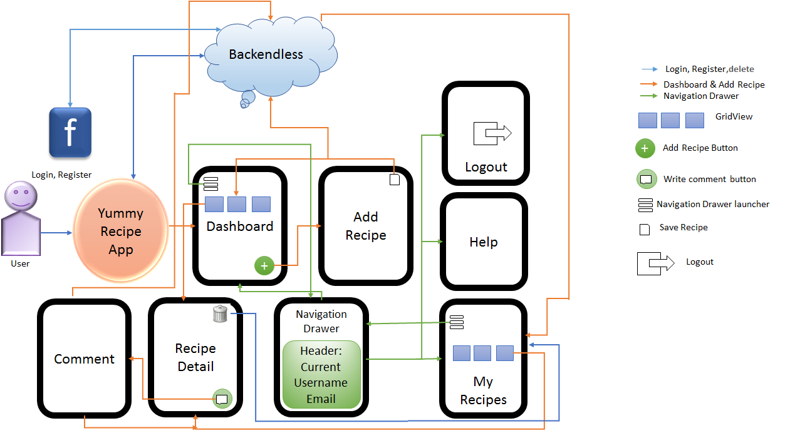
Architecture

Slide 8
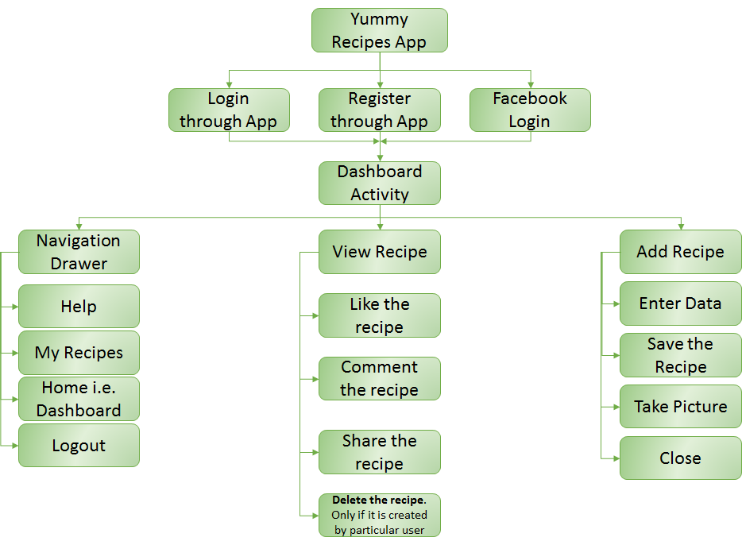
System View

Slide 9
Demo
Demo on Emulator.

Slide 10
Challenges
Figuring out which Database would be easy to use.
Creating Data relationships on the database
Implementing Share feature through Facebook messenger, Gmail, Whatsapp and Native Email application.
Facebook Login through Backendless.
Coordination among team members.

Slide 11
Lessons Learned
Design concepts UI layouts.
Sharing data on different applications.
Easy use of Backendless to store data on cloud.
User Management Through Backendless.
Integration of different modules.
Learned about async calls to retrieve data and show in the UI.

Slide 12
Future Modifications
Adding Notifications.
Adding multiple images for one recipe.
Implementing Android Beam or NFC.
Create a tutorial for the help instead of asking people to go to the website

Slide 13
References
developer.android.com - For android developement
Stackoverflow.com - For general help, implementing share and debugging
Backendless.com - For backend api and help
Code.tutsplus.com - For implementing share intent.
Material Design - For icons.

Slide 14


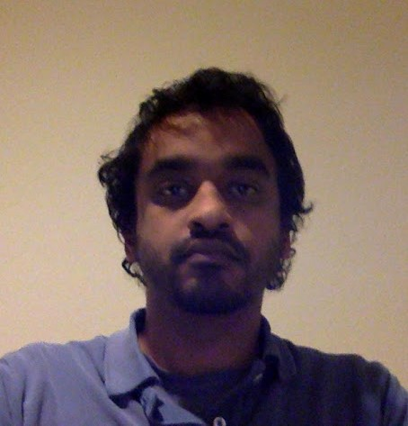
Group Photo
Abhilasha | Rachna | Santhosh

Slide 15
Thank You…

